Slide 1
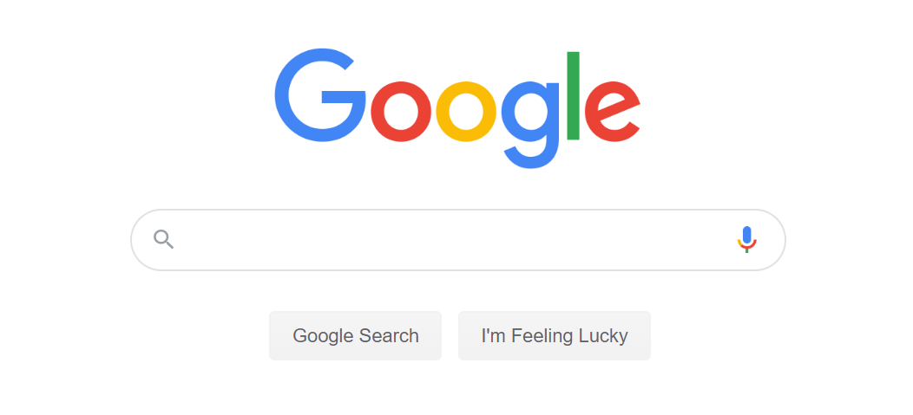
Google search

Slide 2
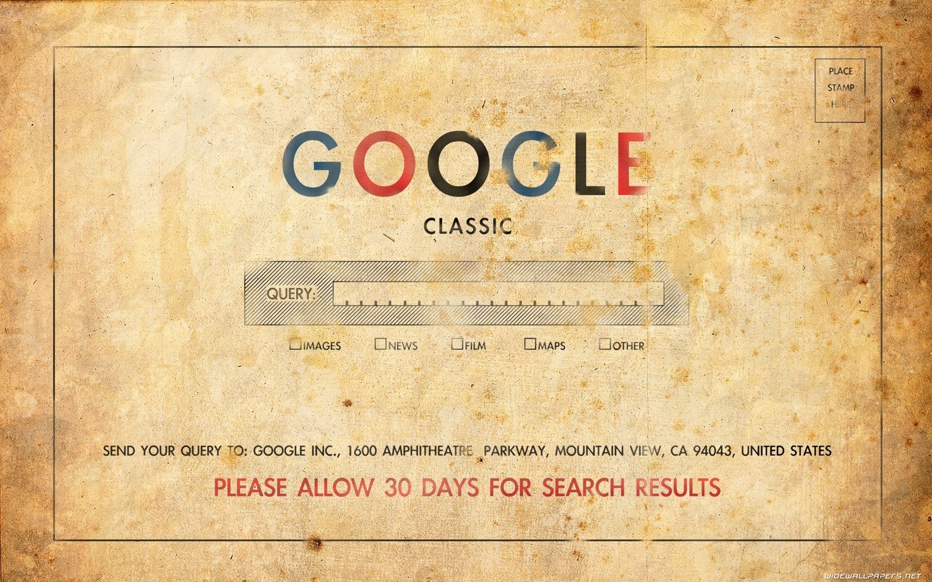
Brief History
The History of Google Search
Do people really need it?

Slide 3
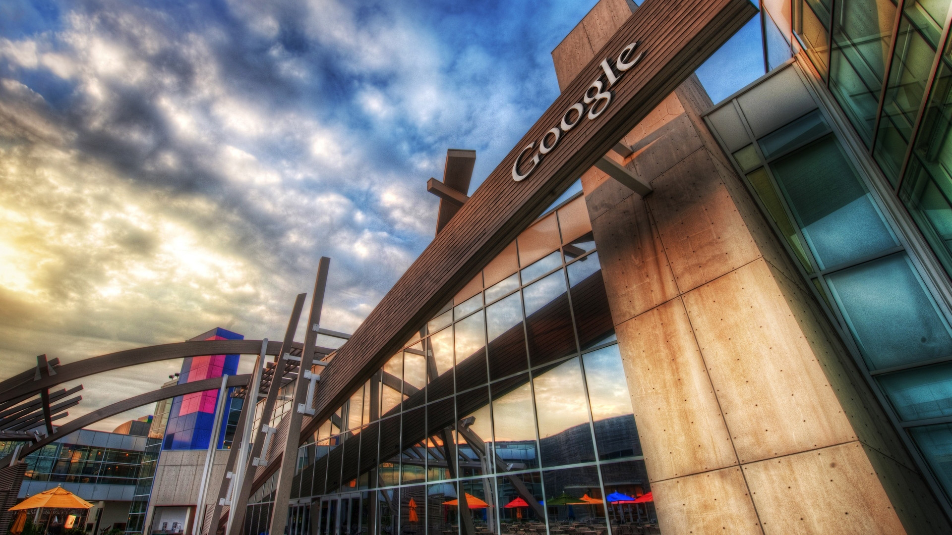
Reception of Google Search
Are we better without Google Search?

Slide 4

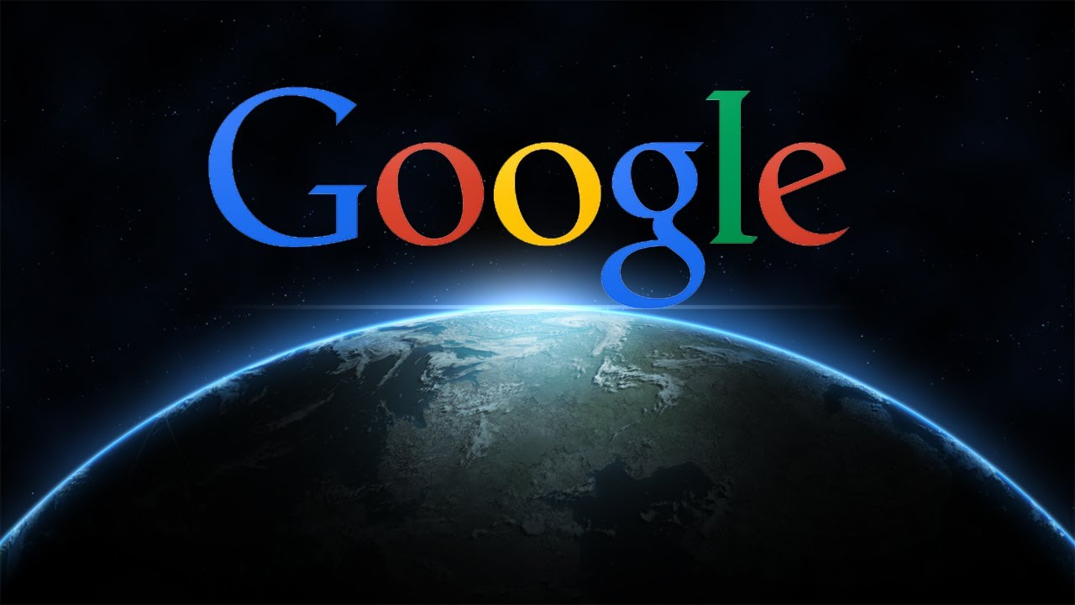
Google and the world
Unexpected uses of Google Search
How did Google Search changed the world

Slide 5
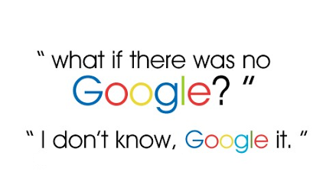
Google Search
Could we live without Google Search
What will happen without Google Search？

Slide 6


The Conclusion
Please do not hesitate If you have any question!

